Slide 1
On survival and destruction of cratons
Jyotirmoy Paul
Centre for Earth Science
Indian Institute of Science
Email: jyotirmoyp@iisc.ac.in
https://jyotirmoyp.github.io

Slide 2

About me
PhD student at the Indian Institute of Science, Bangalore
Research Interest:
Developing numerical modeling to understand the mantle dynamics
PhD topic:
Understanding dynamics and evolution of cratons

Slide 3
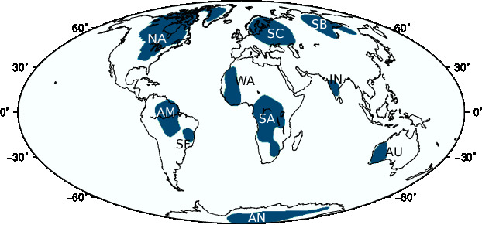
Craton: The unique lithosphere
Thicker lithosphere (>200 km)
No significant deformation after Cambrian
Low heat flow
High seismic velocity anomalies
Present day approximate location of cratons
(Nataf and Richard, 1996)
NA: North America; AM: Amazonia; SF: Sao Francisco; AN: Antarctica;
SC: Scandinavia; WA: West Africa; SA: South Africa; SB: Siberia;
IN: India; AU: Australia

Slide 4
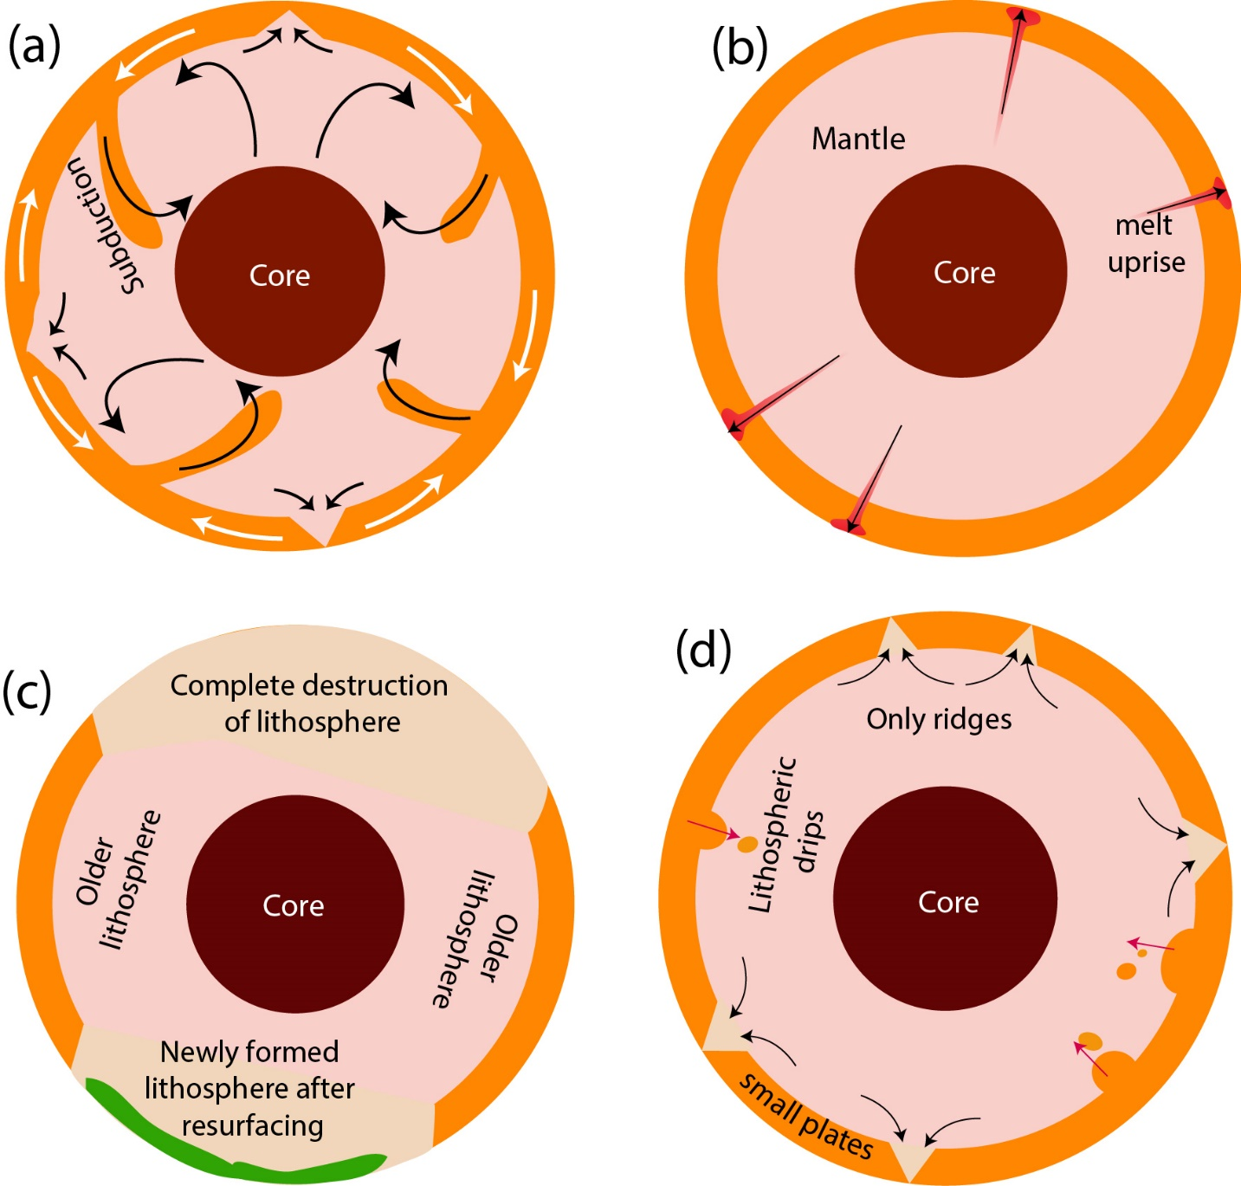
Why do we bother?
What was the mode of tectonism in the early Earth?
Heat pipe
Episodic lid
Squishy plume-lid
Cratons are the natural museum of Earth’s evolutionary history and a key to understand Archean-Hadean geodynamics.

Slide 5
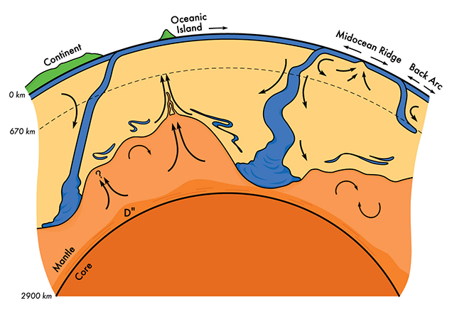
Craton survival: A paradox of plate tectonics
Tectonic recycling:
Old lithosphere subducts into mantle, new lithosphere is produced.
Kellogg et al., 1997, Science

Slide 6
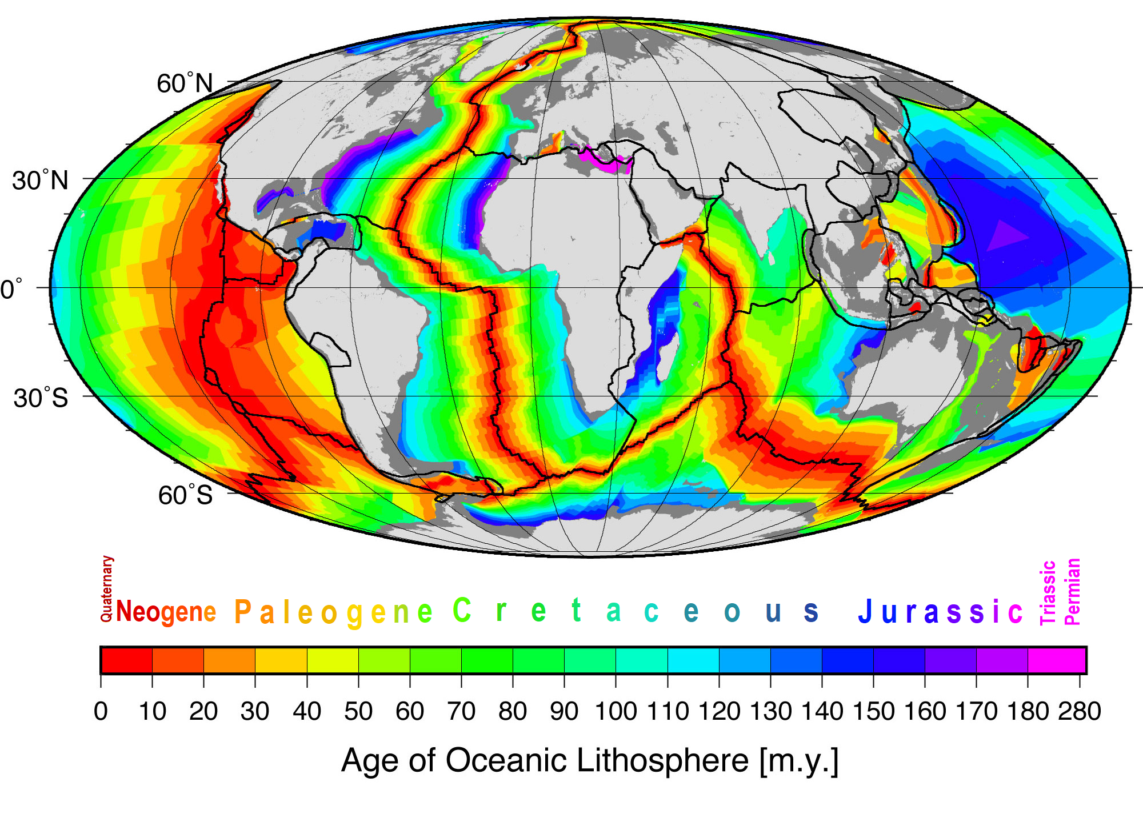
Craton survival: A paradox of plate tectonics
Age of oceanic plates:
No oceanic lithosphere is older than ~280 Ma.
Muller et al. 2008, G3

Slide 7
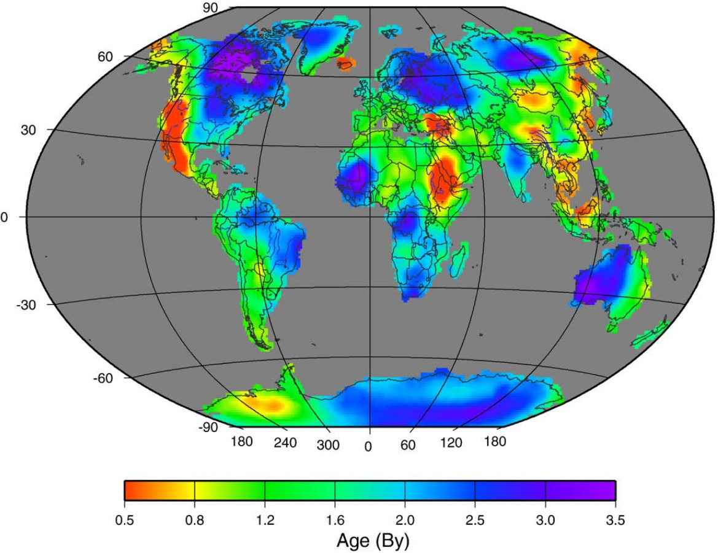
Craton survival: A paradox of plate tectonics
Age of continental lithosphere:
Most common ages are around ~1.5-1.0 Ga.
~5% are older up to ~3.0-3.5 Ga.
Poupinet and Shapiro, 2009, Lithos

Slide 8
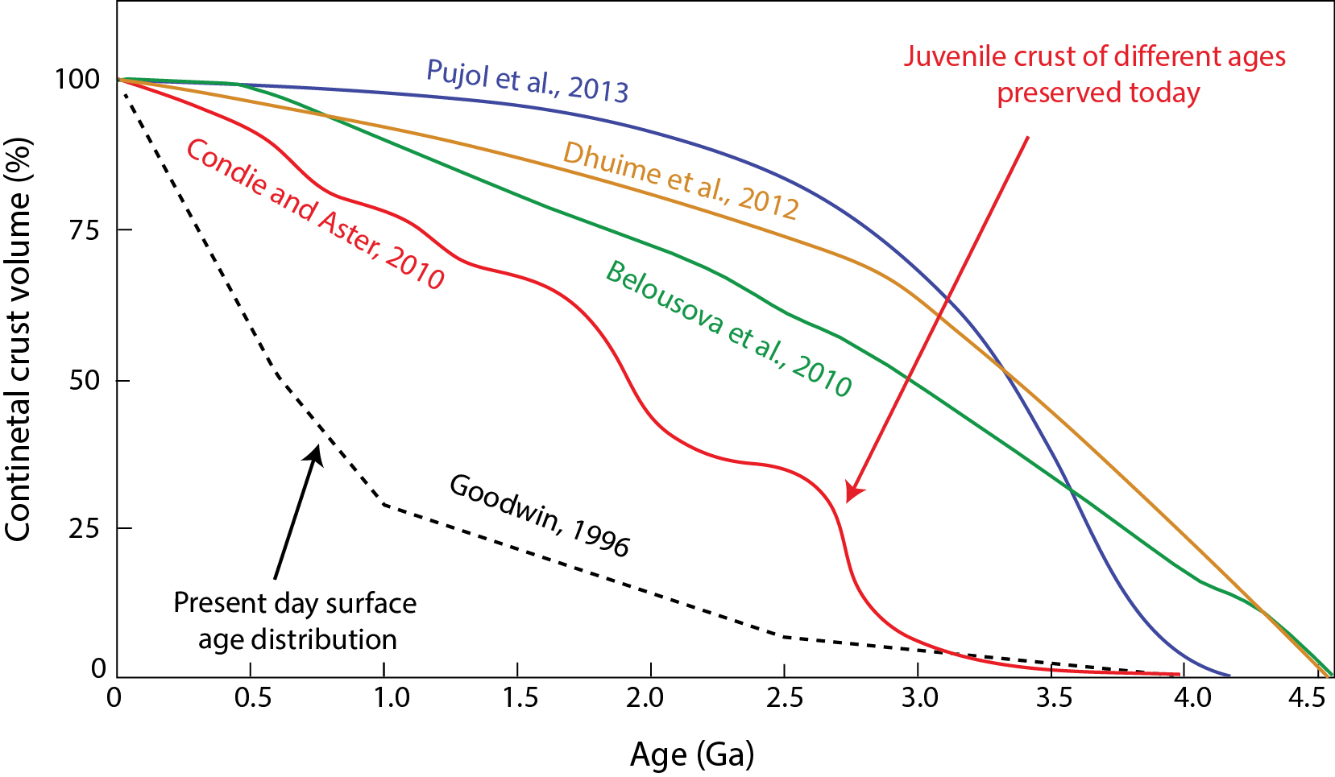
Craton survival: A paradox of plate tectonics
~65-70 % volume of present day continental crust was produced by 3 Ga, of which only ~5% are remaining today!
How could they survive?
(Hawkesworth, et al., 2017, Annu. Rev. Earth. Planet. Sci.)

Slide 9
Part A
Survival of cratons

Slide 10
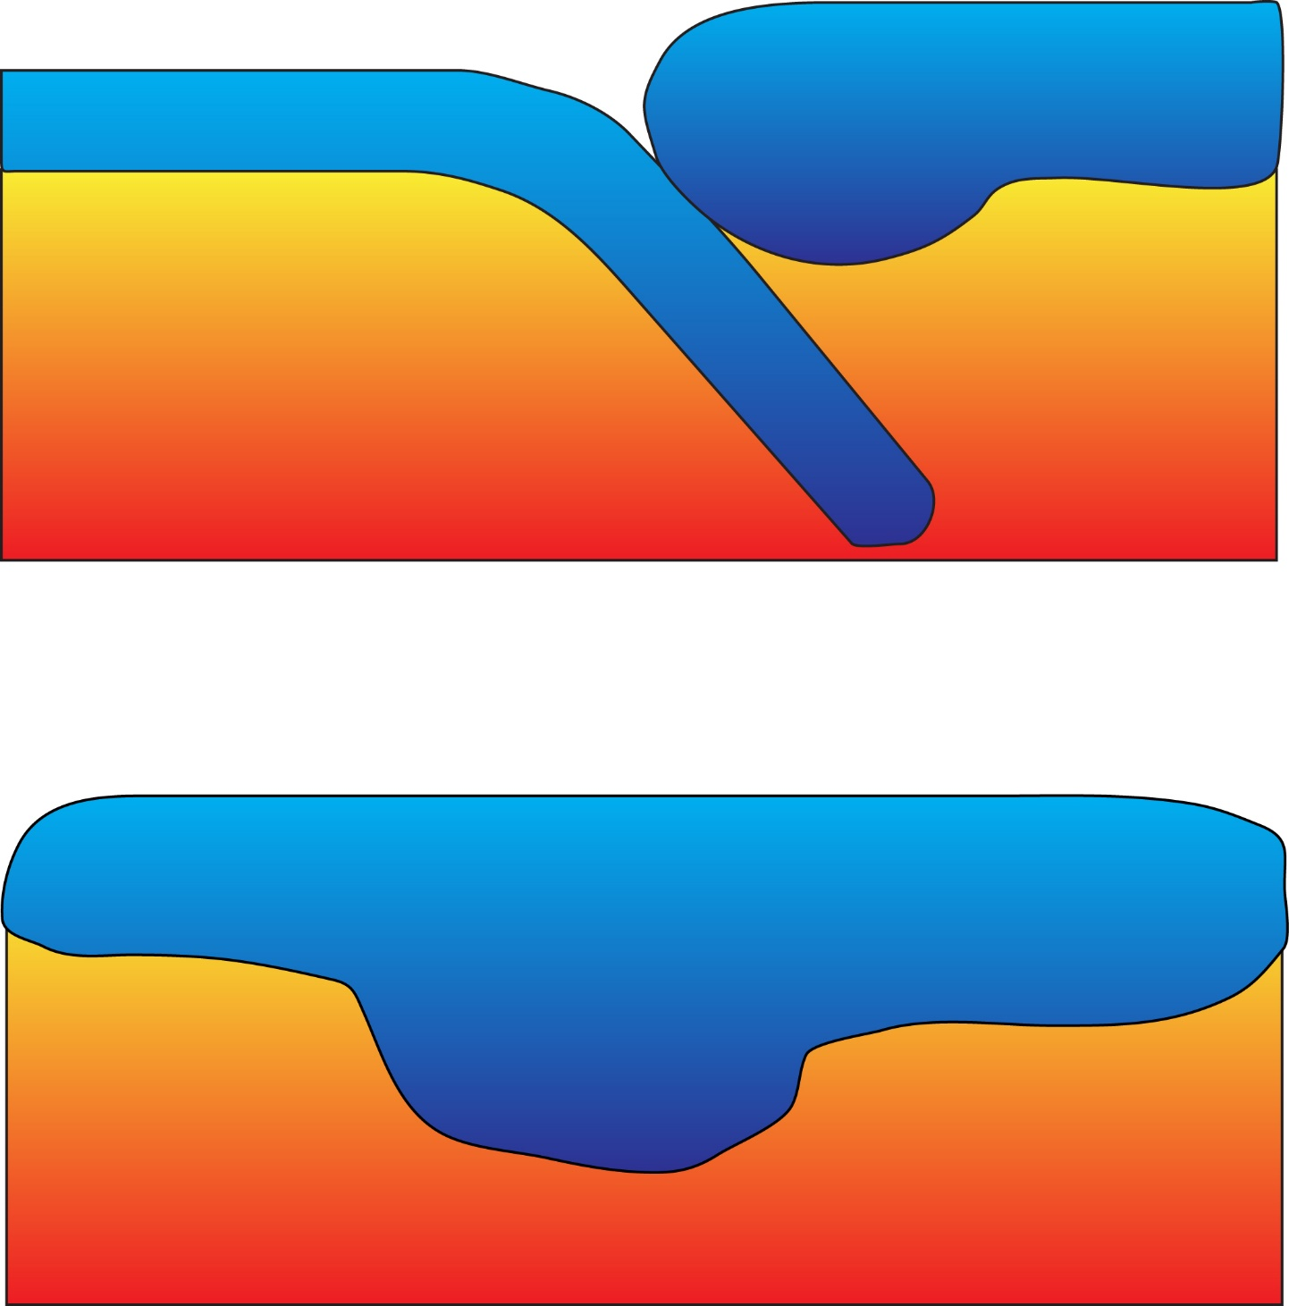
How lithosphere can be destroyed?
Subduction: primarily for oceanic lithosphere
Gravitational delamination: for dense continental lithosphere/ thermal erosion
Convective erosion: force exerted by underlying mantle at the base of the lithosphere

Slide 11
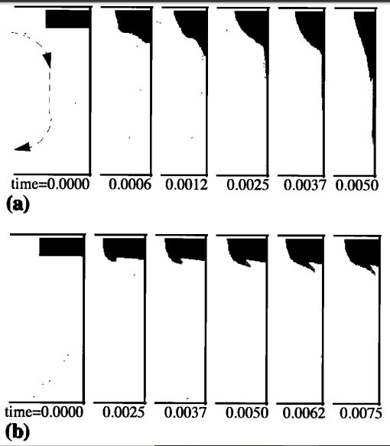
Tectoshpere hypothesis: Overcoming the gravitational instability
Destruction mechanisms
Subduction
Delamination
Convective erosion
Cratons are made up of lighter elements that make them neutrally buoyant and thus do not undergo delamination.
(Jordan, 1975, 1978)
Only buoyancy can not protect cratons from convective erosion
What else? Viscosity/ material strength
Lenardic and Moresi, 1999, GRL

Slide 12
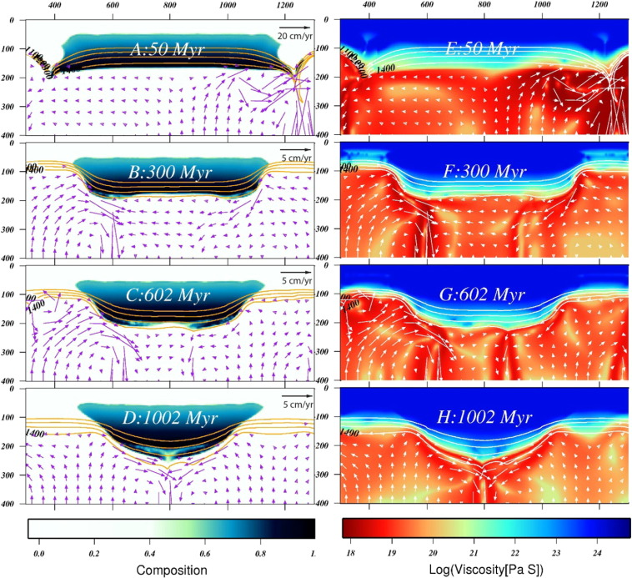
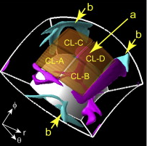
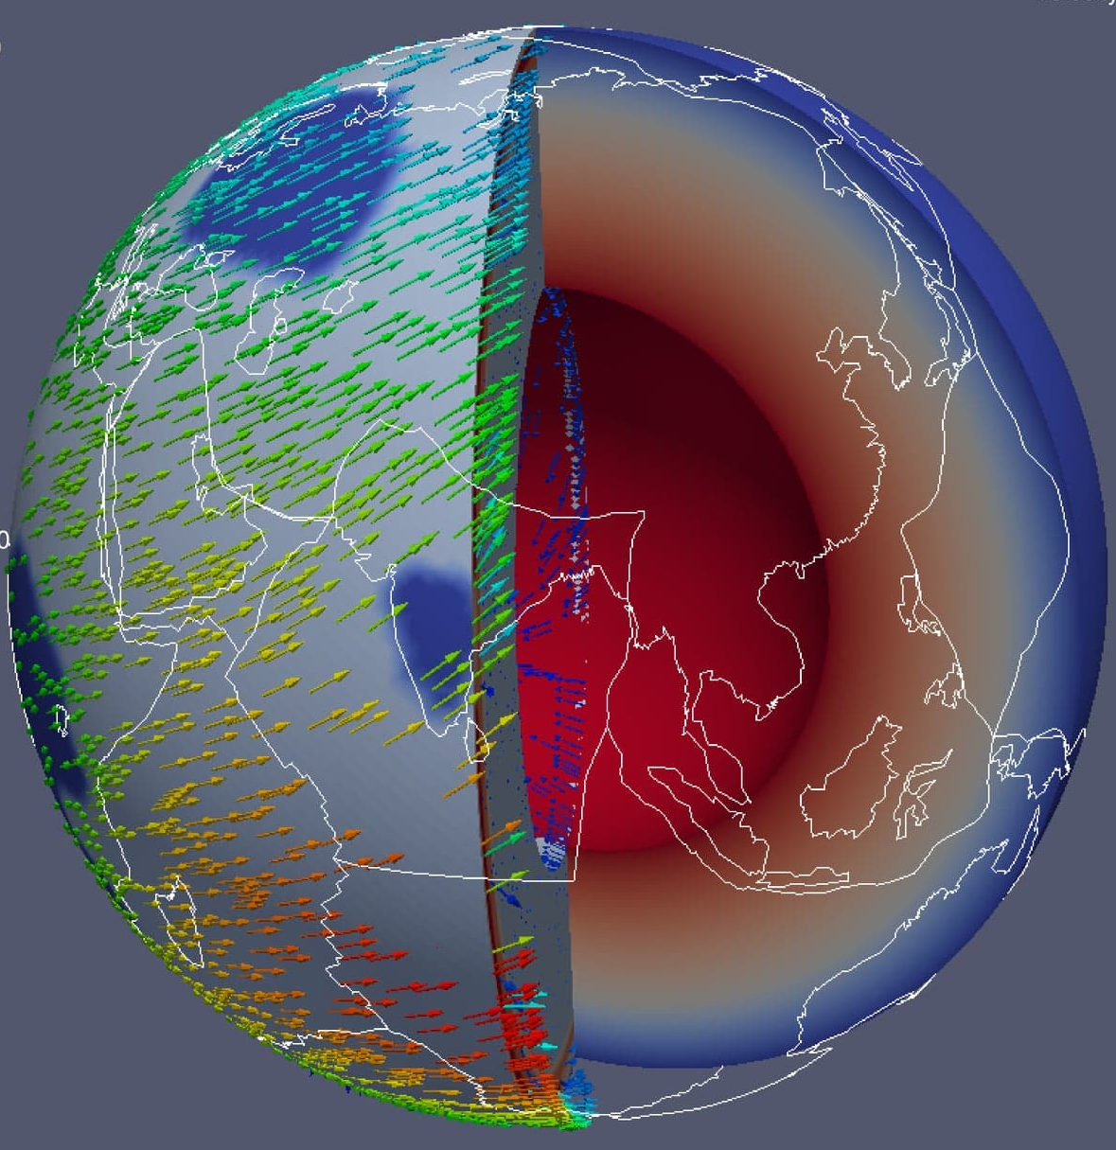
Aim: Estimate of craton viscosity
Wang et al., 2018, Tectonophysics
Yoshida, 2012, Tectonophysics
Studies estimated craton viscosity in 2-D box model, 3-D regional models. But a complete understanding of craton evolution process and estimate of craton viscosity in a 3-D global mantle convection model is lacking.

Slide 13
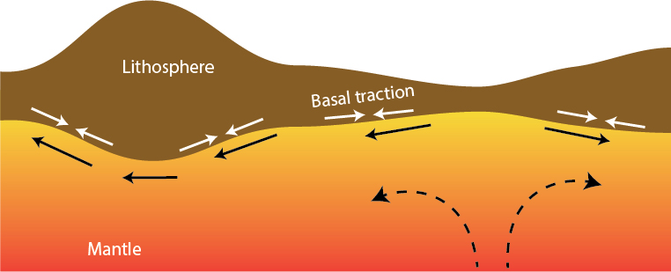
Understanding viscosity from traction strain-rate relation
How does mantle traction deform lithosphere?
Does it vary with lithospheric thickness and viscosity?

Slide 14
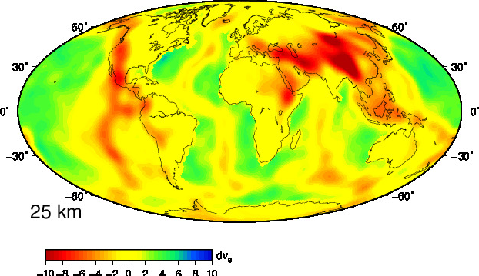
Instantaneous convection modeling
FE code CitcomS to solve convection equations (Zhong et al., 2000).
Input density:
1. Velocity anomalies obtained from seismic tomography are converted to density anomaly, using density-velocity scaling. Density anomalies drive the mantle convection in our models
2. High velocity anomalies are removed below the continents to make them neutrally buoyant.
SMEAN2 tomography (using approach of Becker and Boschi, 2002)

Slide 15
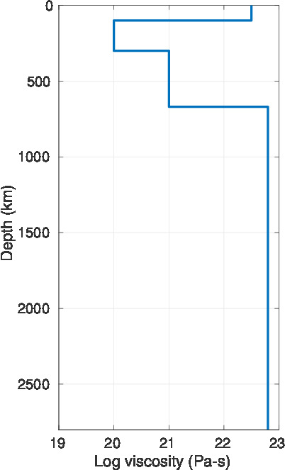
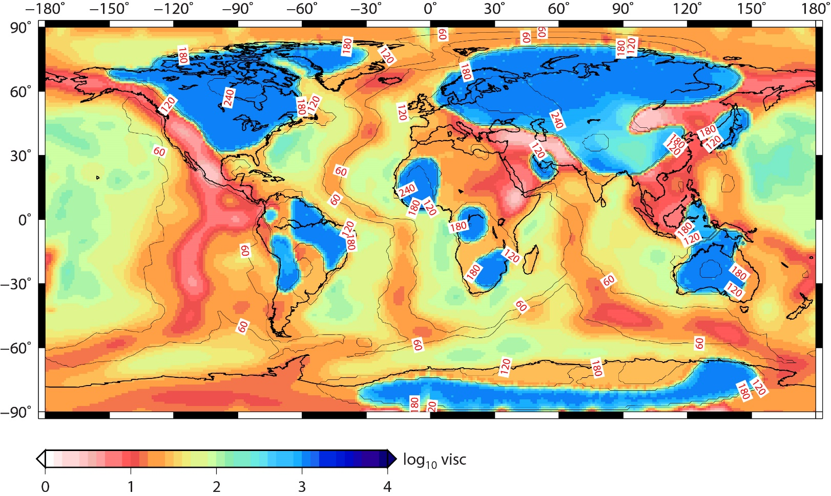
Mantle viscosity structure
Radial viscosity variation
Lateral viscosity variation
(ref. visc., 1)
Viscosity of asthenosphere: 10¹⁹ (0.01) to 10²¹ (1)Pa-s
Cratons: 10 to 1000 times more viscous than the surroundings
(Paul et al., 2019, GJI)

Slide 16
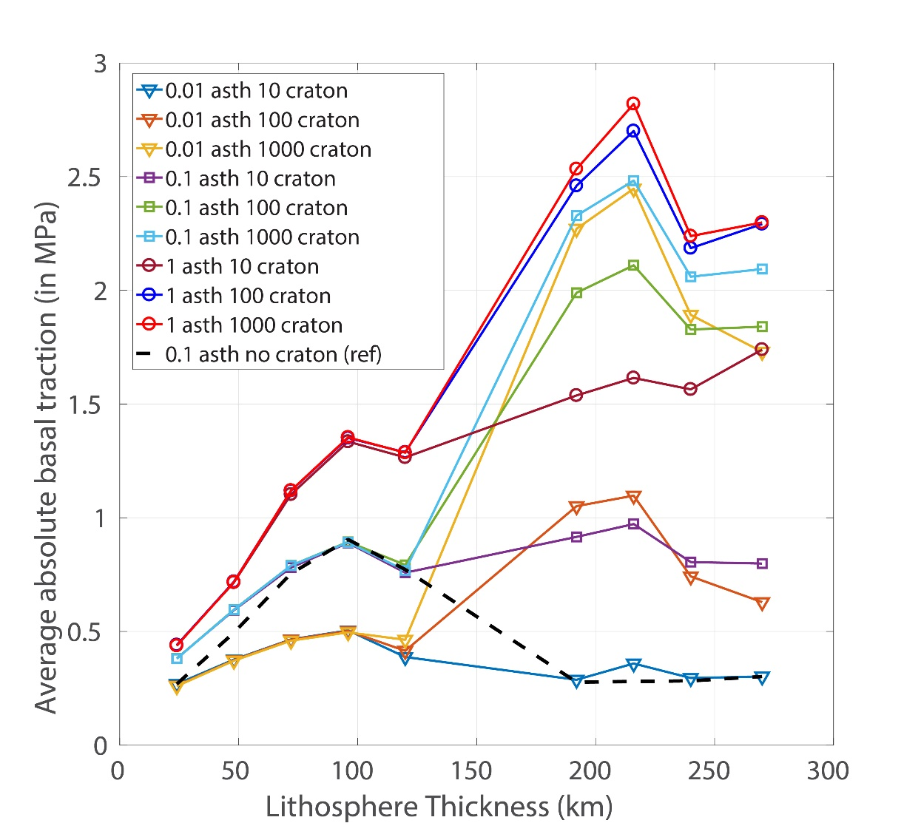
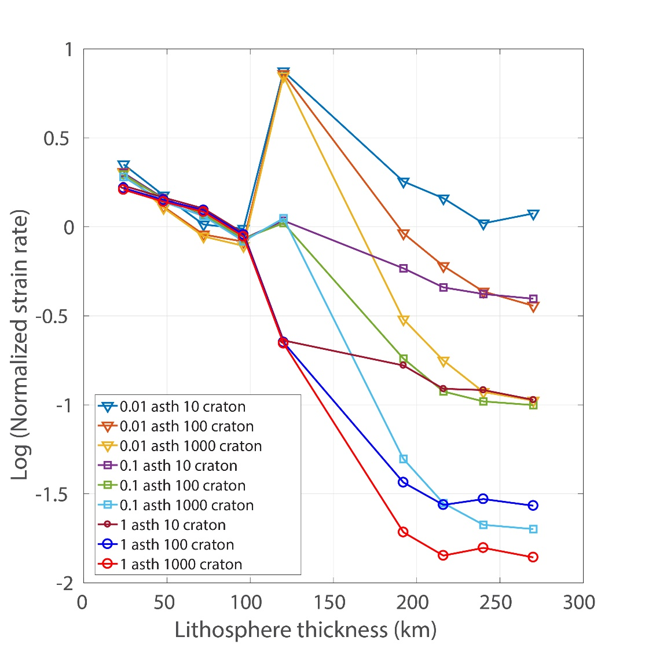
Deformation at the base of the lithosphere
Traction and strain-rates are inversely related: Key to craton survival
(Paul et al., 2019, GJI)
(Paul et al., 2019, GJI)

Slide 17
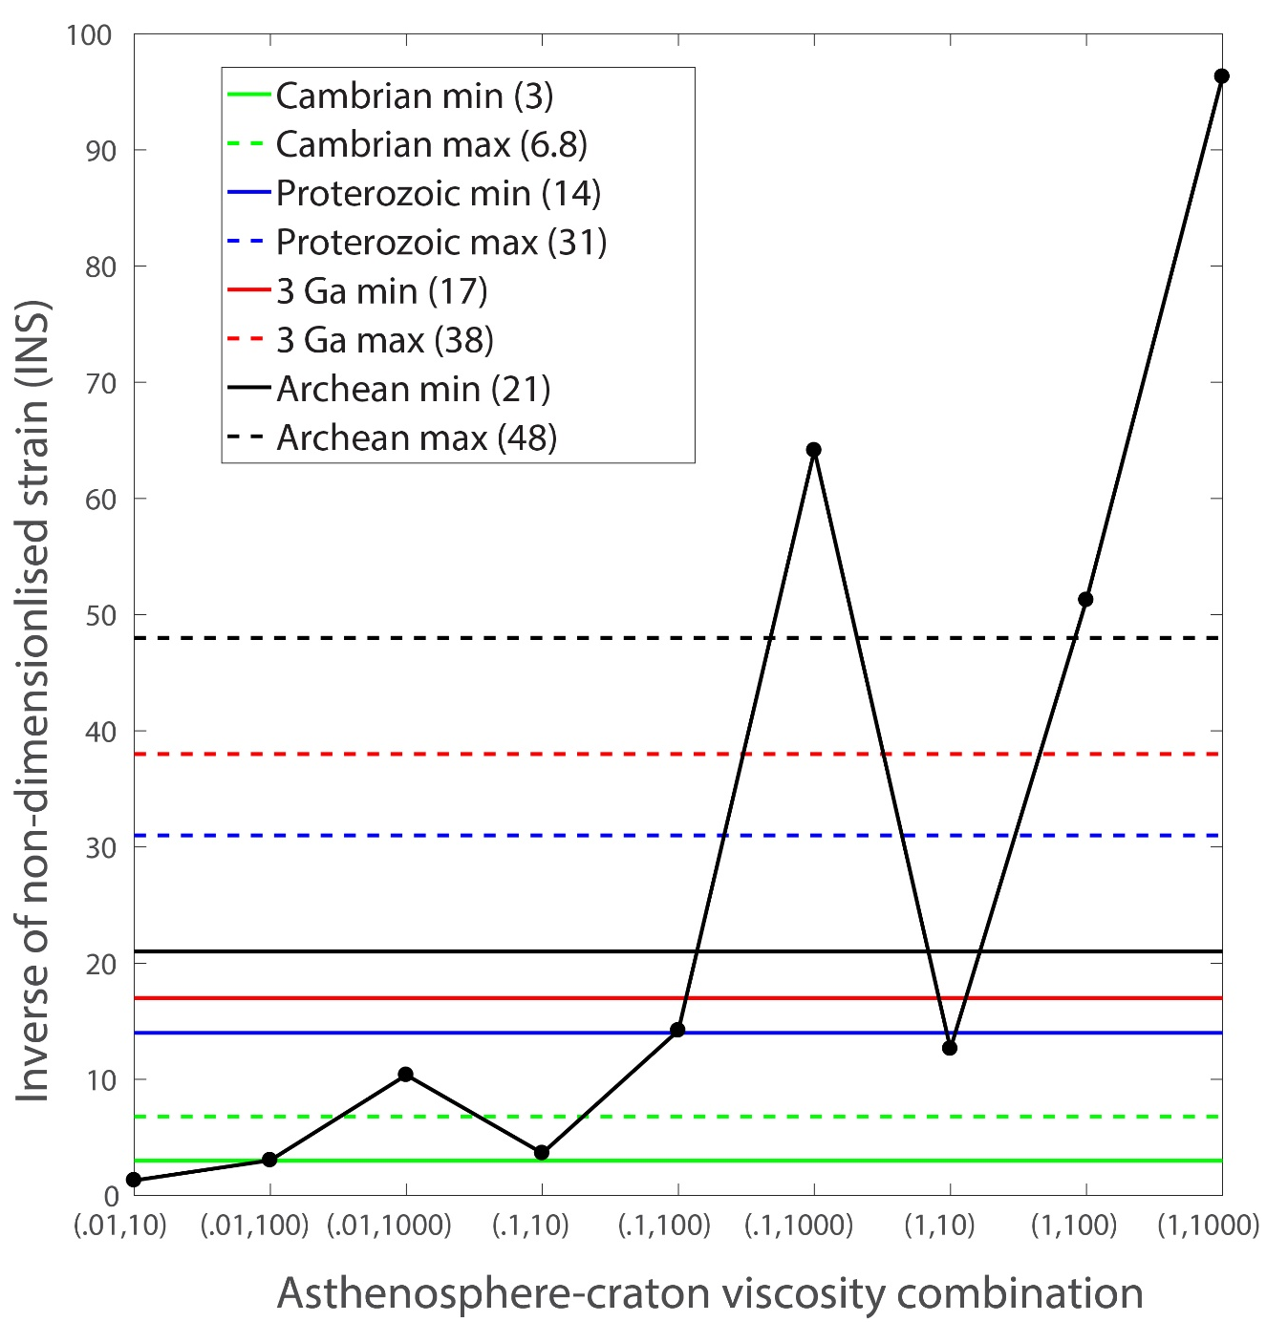
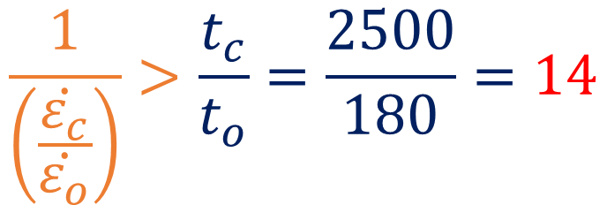
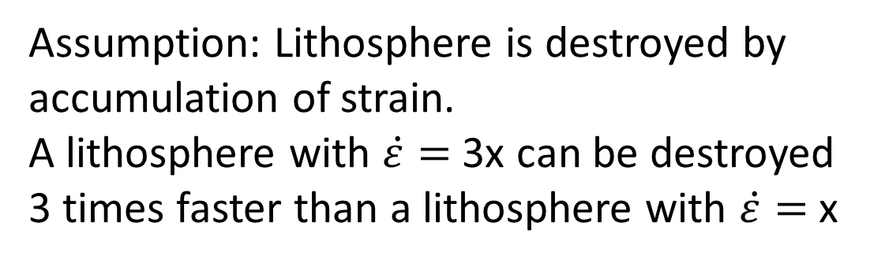
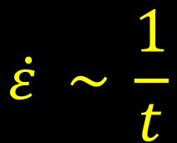
Estimating stable viscosity combination
Assumption: Lithosphere is destroyed by accumulation of strain.
A lithosphere with $\dot{ε}=$ 3x can be destroyed 3 times faster than a lithosphere with $\dot{ε}=$ x
(Paul et al., 2019, GJI)
Survival condition
$$\dot{ε} \sim \frac{1}{t}$$
$$\frac{1}{\left(\frac{\dot{ε_{c}}}{\dot{ε_{o}}}\right)}>\frac{t_{c}}{t_{o}}=\frac{2500}{180}=14$$
INS
(0.1,100) – Can survive since 2500 Ma
(0.01,10) – Can not survive since Cambrian
(0.1,10) – Marginally survive since Cambrian (540 Ma)
(Paul et al., 2019, GJI)

Slide 18
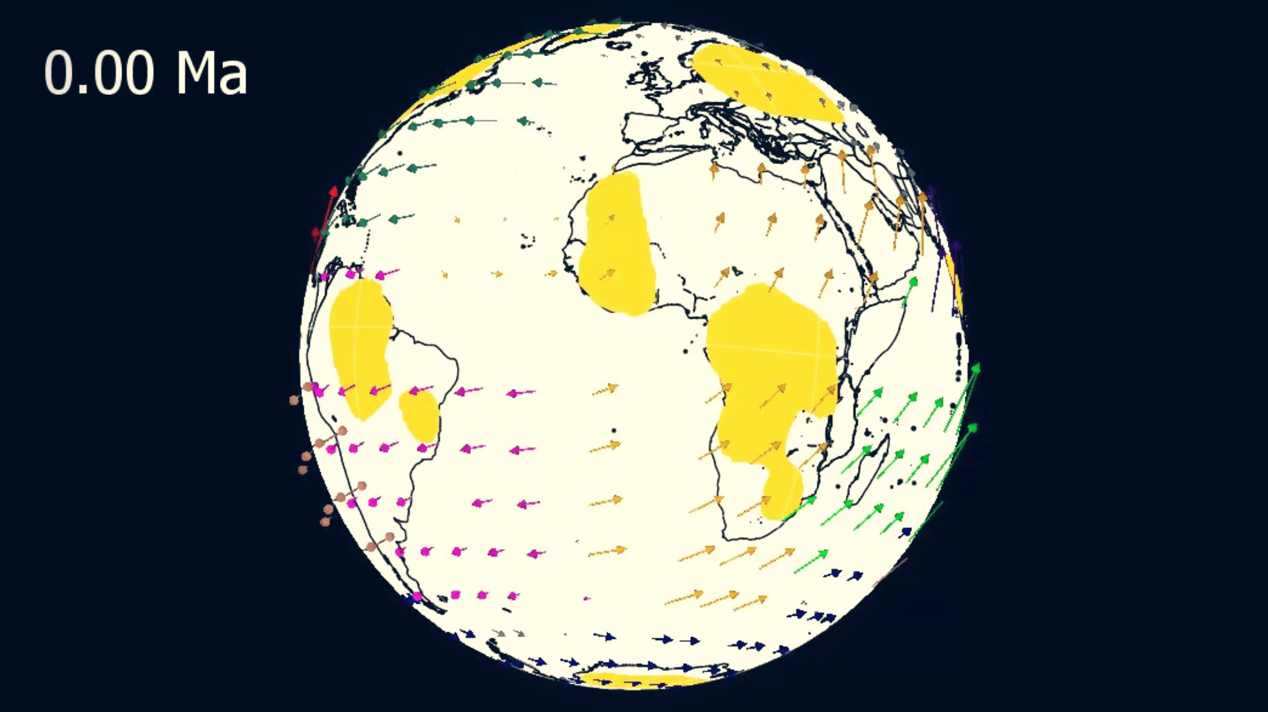
Are these viscosity estimates valid for time-dependent models?
Viscosity estimate from instantaneous models: Asthenosphere viscosity not less than 10²⁰ Pa.s, and craton should be 100 times viscous than the surroundings.
Idea: Test this estimate in time-dependent models
Problem: No density data is available to run mantle convection models
Solution: Reconstructed plate velocity can drive the convection

Slide 19
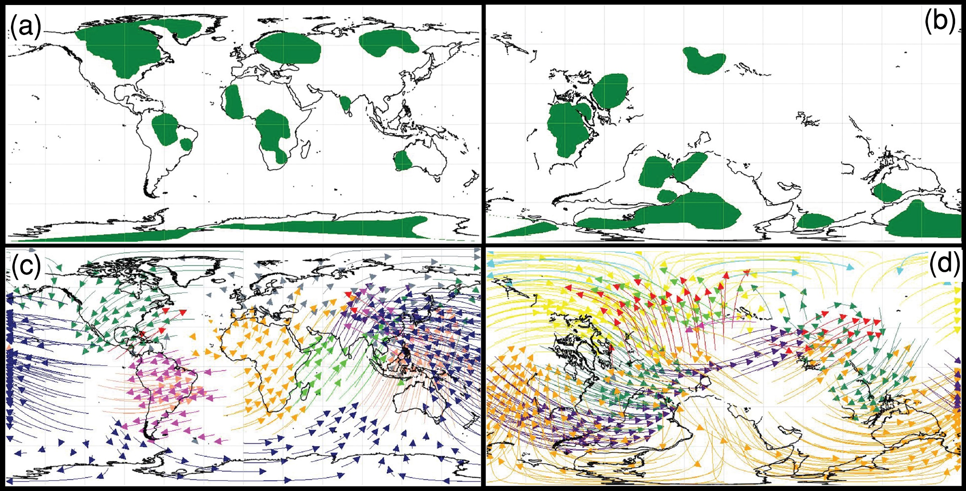
Reconstructing craton locations
409 Ma
Present day craton locations are reconstructed till 409Ma.
Plate velocity was extracted at every 1 Myr interval.
Present day
Reconstruction based on Matthews et al., 2016.
(Paul and Ghosh, 2020, EPSL)

Slide 20
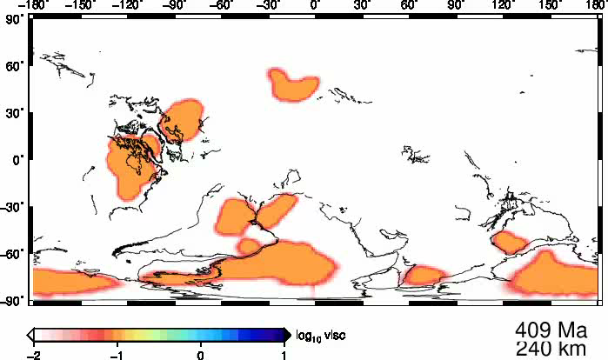
Evolution of cratons: Weakest case
10 times viscous
cratons within
asthenosphere
0.01 (10¹⁹ Pa-s)
(Paul and Ghosh, 2020, EPSL)

Slide 21
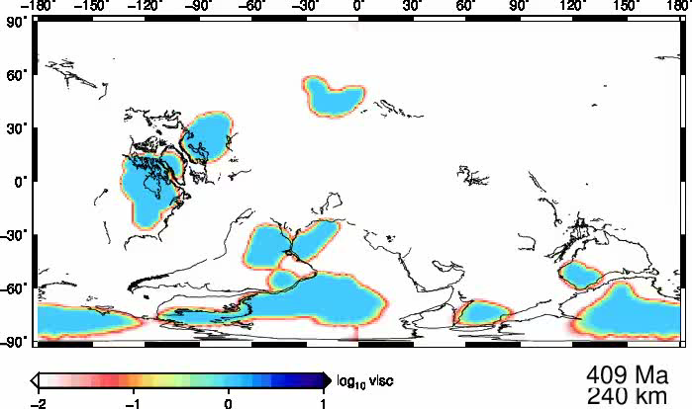
Evolution of cratons: Intermediate case
100 times viscous
cratons within
asthenosphere 0.01 (10¹⁹ Pa-s)
(Paul and Ghosh, 2020, EPSL)

Slide 22

Evolution of cratons: Stronger case
100 times viscous
cratons within
asthenosphere 1 (10²¹ Pa-s)
(Paul and Ghosh, 2020, EPSL)

Slide 23
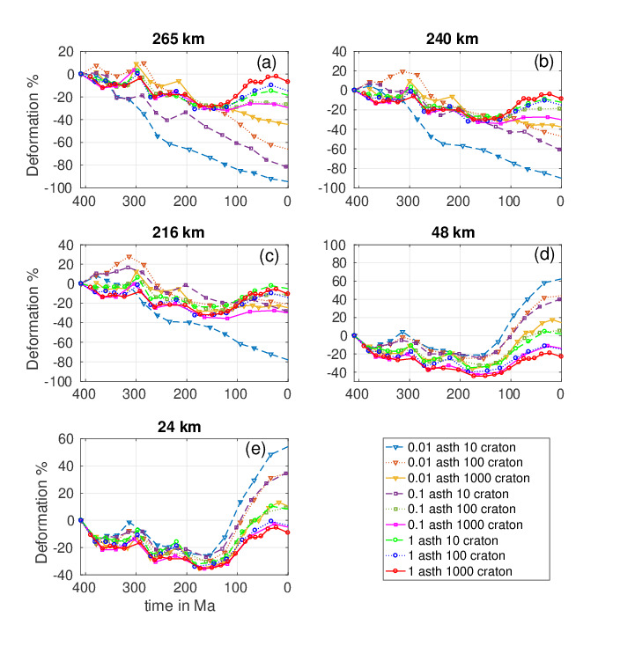
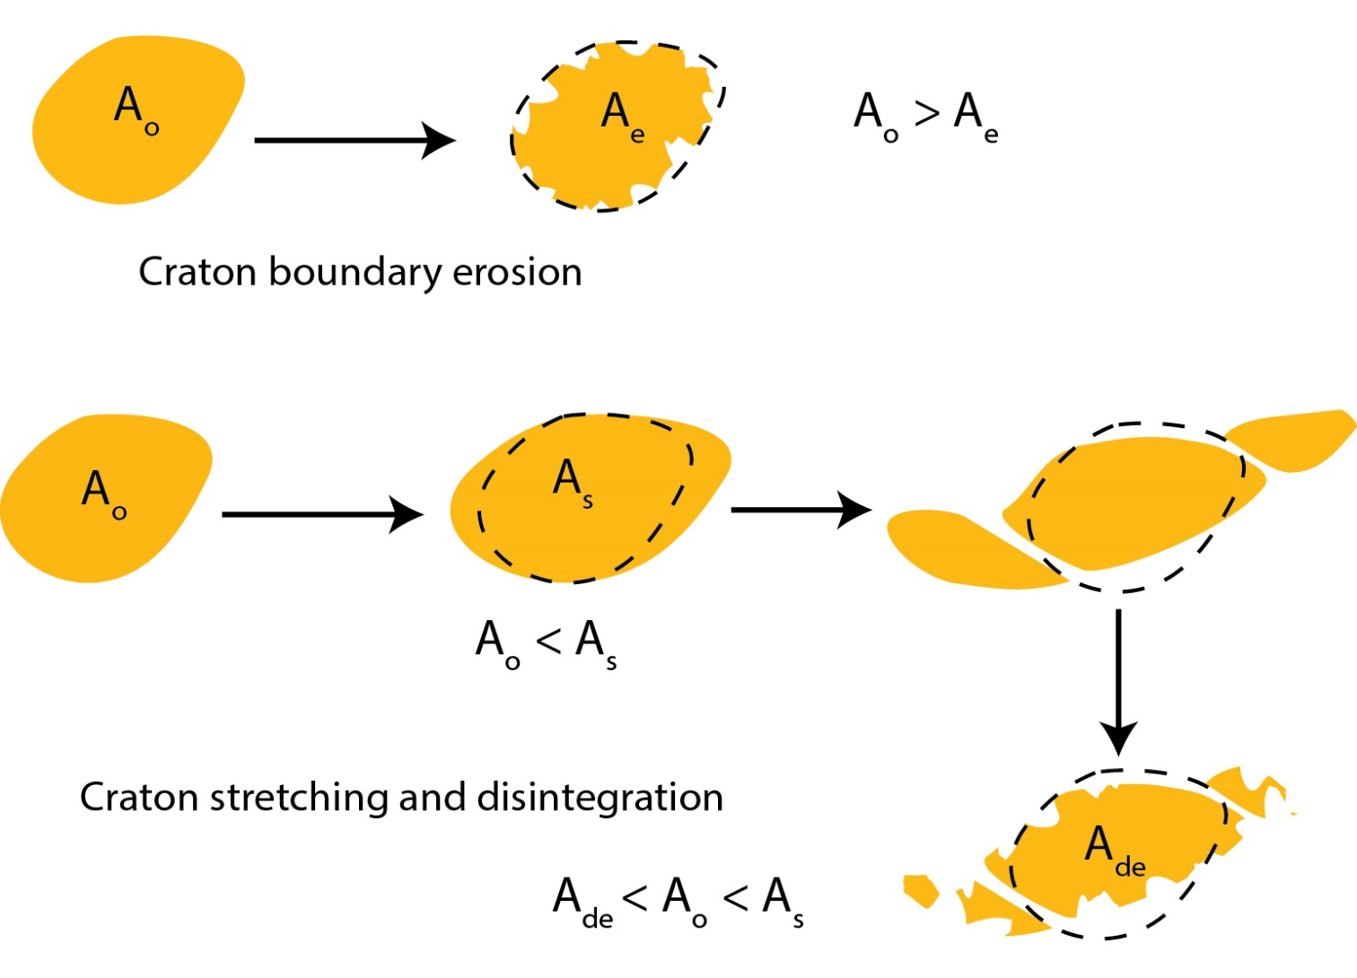

Quantifying deformation
$$\frac{A_{t} − A_{409}}{A_{409}}×100$$
(Paul and Ghosh, 2020, EPSL)
(Paul and Ghosh, 2020, EPSL)

Slide 24
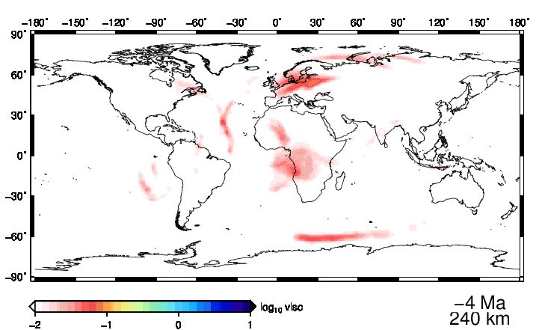
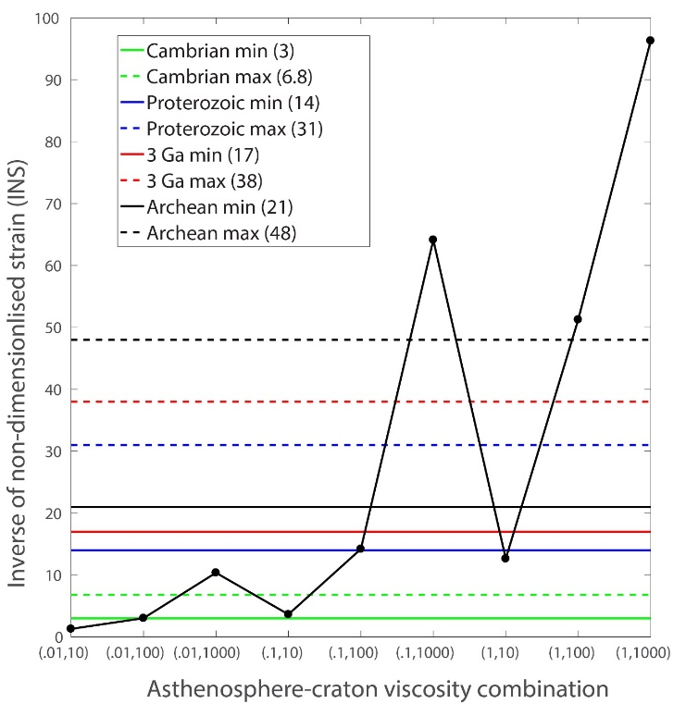
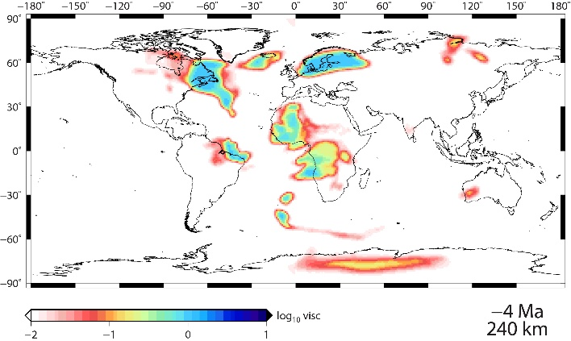
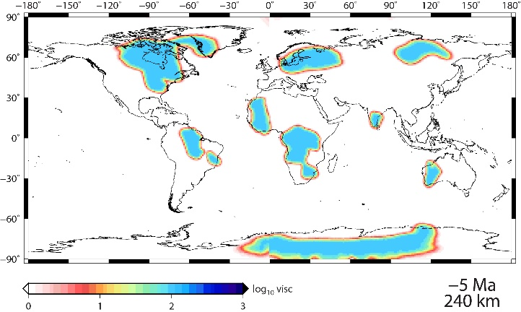
Comparing results with instantaneous models
Does not
survive till 410 Ma
Marginally survives till
410 Ma
Barely deforms in 410 Ma
(Paul and Ghosh, 2020, EPSL)

Slide 25
Conclusions
Thick and highly viscous cratons can resist deformation in spite of undergoing highest traction
Asthenosphere plays an important role in the survival of cratons
For long-term survival of cratons, they need to be at least 100 times viscous than the surroundings and asthenosphere viscosity should not be less than 10²⁰ Pa-s

Slide 26
Part B
Destruction of cratons

Slide 27
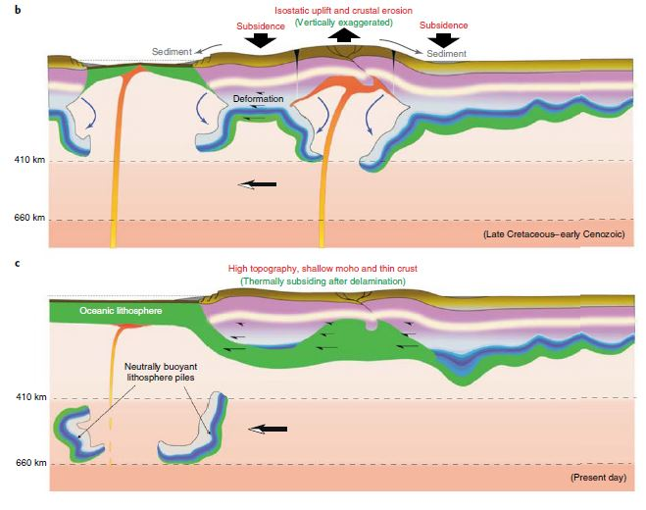
Cratons are not immortal!
North China craton is the more prominent example of craton destruction due to weakening induced by fluids generated from subduction zone.
Plume-craton interaction can trigger craton destruction (eg. Indian craton, Kumar et al. 2007)
Hu et al., 2018, Nature Geoscience.

Slide 28
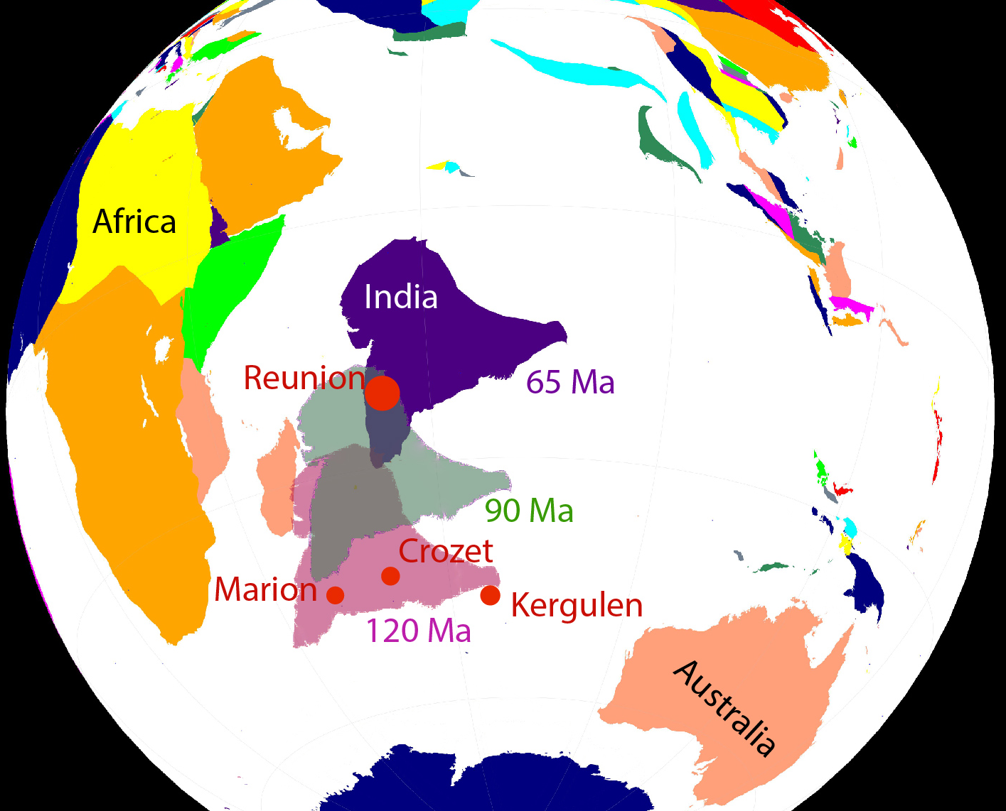
History of the Indian plate
Kerguelen at ~120 Ma
Marion at ~90 Ma
Reunion ~65 Ma
Did the Indian craton get thinned
while interacting with the Reunion plume at ~65 Ma? (Kumar et al., 2007)
Reconstructed plate geometries at 65 Ma based on Matthews et al., 2016

Slide 29
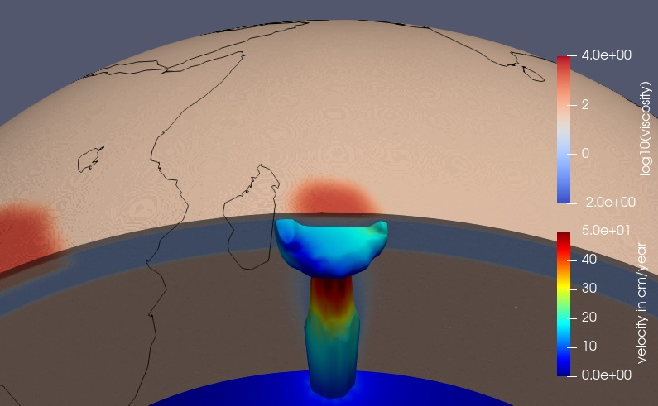
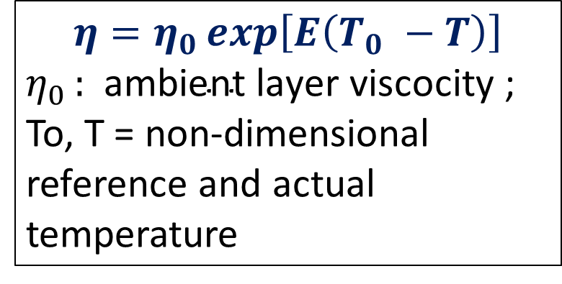
Model setup
A plume at 1600ºC beneath the Indian craton
Drive mantle convection with reconstructed plate velocities
Indian craton at 65 Ma
$$η=η_{0}\exp\left[E\left(T_{0} −T\right)\right]$$
$η_{0 }:$ $\text{ambient} \text{layer} \text{viscocity}$; To, T = non-dimensional reference and actual temperature
Without plume, 2) With plume, no temperature-dependent viscosity (E = 0)
3) With plume and moderate temperature-dependent viscosity (E=5)
4) With plume and strong temperature-dependent viscosity (E = 10)

Slide 30
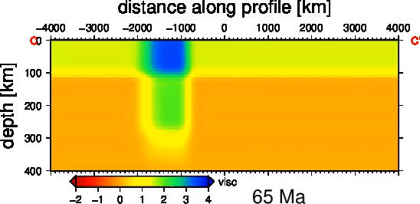

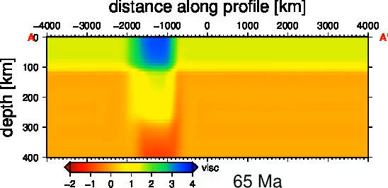
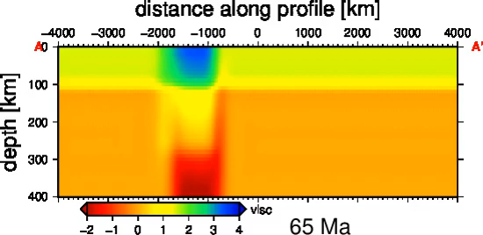
Plume-craton interaction: Viscosity profile
No Plume
E = 0
[1,100]: 1 Asthenosphere (10²¹ Pa-s), 100 times stronger craton
E = 5
E = 10
(Paul and Ghosh, In prep)

Slide 31
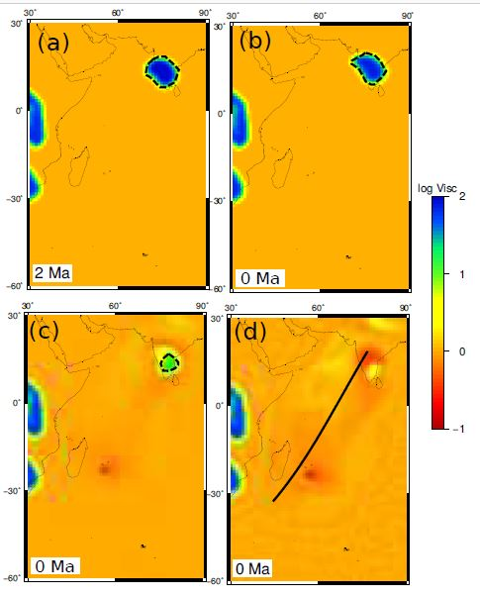
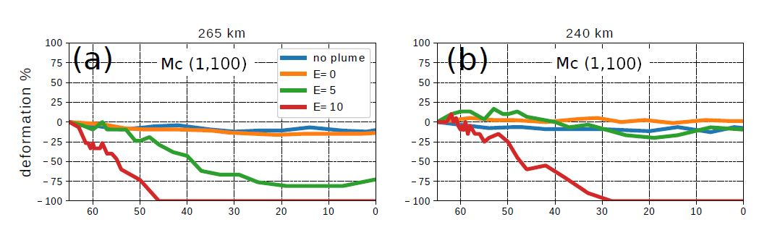
Quantifying shortening of the cratonic root
deformation =
(A_{t}-A_{o})/A_{o} %
265 km
A_{t}=Area at any time A_{o}= Initial area
No Plume
E = 0
265 km
265 km
-100 % deformation means complete destruction of craton at that depth.
Deformation %
240 km
216 km
E = 5
E = 10
265 km
265 km
Time in Ma
(Paul and Ghosh, In prep)

Slide 32
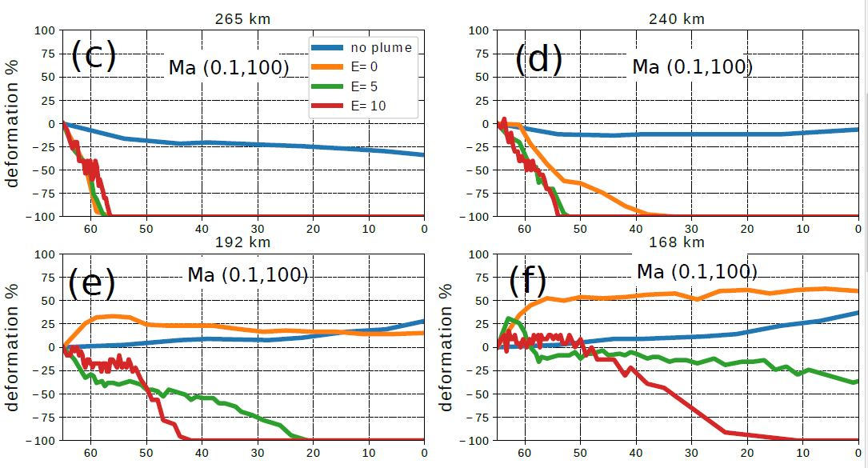
Quantifying shortening of the cratonic root
~130 km root is destroyed for (0.1,100) viscosity combination model
(Paul and Ghosh, In prep)

Slide 33
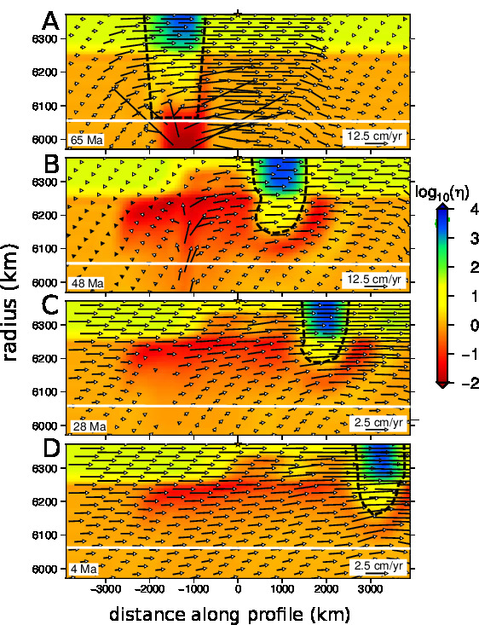
Effect of temperature dependent viscosity on Indian plate velocity
Thinning of craton does not occur at 65 Ma. So, thinning of craton root may have least effect on the velocity of the Indian plate
Plume-induced weakening thin down non-cratonic lithosphere and lubricate the lithosphere-asthenosphere boundary: A potential factor for sustaining the high velocity of Indian plate since 65 Ma.
(Paul and Ghosh, In prep)

Slide 34
Conclusions
Plume-induced thermo-mechanical erosion could have thinned down the Indian craton, if the strength of temperature dependence is high. We found up to ~130 km reduction of cratonic root
Plume could lubricate the lithosphere-asthenosphere boundary – A potential reason for the higher velocity of the Indian plate

Slide 35
Summary
Equipped with higher viscosity and thickness, cratons can resist convective stress: a primary reason for their long term survival.
Cratons need to be at least 100 times more viscous compared to their surroundings and the asthenosphere viscosity should not be less than 10²⁰ Pa-s.
Plume-induced thermo-mechanical erosion can reduce cratonic root thickness. Plume can also lubricate the LAB, which may be a potential reason for Indian plate’s high velocity.

Slide 36
Publications from PhD work
In peer reviewed journals 2. J. Paul, A. Ghosh, 2020, Evolution of cratons through the ages: A time-dependent study, Earth and Planetary Science 1. J. Paul, A. Ghosh, C.P. Conrad, 2019. Traction and strain-rate at the base of the lithosphere: An insight into cratonic survival. Geophysical Journal International
Conference Presentations
8. J. Paul, A. Ghosh, 2021. Interaction of the Indian craton with the Reunion plume. EGU General Assembly, Vienna. 7. J. Paul, A. Ghosh, 2020. Understanding deformation of cratons in presence of mid-lithospheric discontinuity. EGU General Assembly, Vienna. 6. J. Paul, A. Ghosh, 2019, Evolution of cratons in time-dependent mantle convection models. AGU Fall Meeting, San Francisco
5. A. Ghosh, J. Paul, 2019, Effect of Weak Mid-lithospheric Discontinuities on the Survival of Cratons . AGU Fall Meeting, San Francisco
4. J. Paul, A. Ghosh , 2019, Evolution and survival potential of cratons: A numerical study. IUGG General Assembly, Montreal. 3. J. Paul , A. Ghosh, 2018, Stability of cratons since early Phanerozoic. AGU Fall Meeting, Washington DC 2. A. Ghosh, J. Paul , C.P. Conrad, 2018, The Relation Between Tractions and Strain Rate at the Base of the Lithosphere: Key to Understanding Cratonic Stability. AGU Fall Meeting, Washington DC. 1. J. Paul , A. Ghosh, 2018, Variation of traction and strain rate with lithospheric thickness: An insight into understanding cratonic stability. EGU General Assembly, Vienna.

Slide 37
Articles for science-society communication
5. Cratons! Why are you still Here, 2021, AGU EOS
4. 2021: 100th Year of the craton concept and top three problems associated with cratons, 2021, European Geoscience Union, Geodynamics division
3. পৃথিবীর গভীর কথা, 2020, বিজ্ঞান
2. Geoscience in the third world, 2020, European Geoscience Union, Geodynamics division
1. How did the Oldest Part of the Earth Still Survive Today, 2020, AWSAR Scheme, Department of Science and Technology, India

Slide 38





Research collaboration and funding agencies

